Slide 1
EE400D SAWS Team Results Presentation
Presented by Sakib Karim and Jordan HSU
In Collaboration with: Matt Rosales, Garrett Bondoc, and James Donahue

Slide 2
Requirements
3.1.1 – (I) The gantry shall contain an electronics enclosure to house electronic components
3.3.2 – (I) The gantry shall have mounts for sensors
3.3.4 – (I) The gantry shall rigidly mounted

Slide 3
Changes from the reference
Timing belt → Gear System
Increased solar panel area to provide room for sensors and solar panel
Lengthen the enclosure for electronics
Covering for BME 280

Slide 4
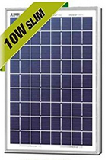
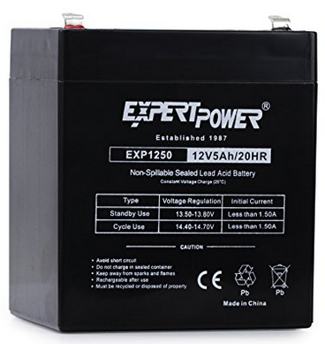
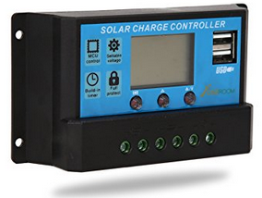
Power Results
Solar panel: 10W 12V polycrystalline solar panel
Charge controller: Solar Charger Controller/ Regulator w/ Dual USB port
Sealed Lead Acid battery 5Ah

Slide 5
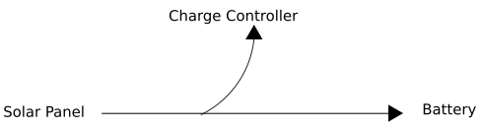
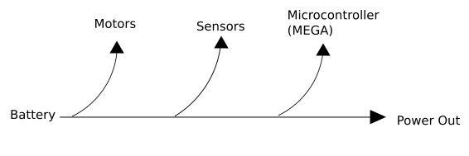
Power flow diagram

